Slide 1

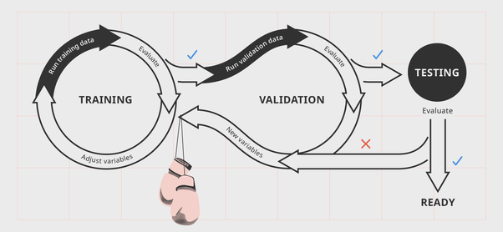
MCSE0007: Machine Learning
Training and Testing, Evaluation
Class Presentations on Machine Learning by Prof. Anand Singh Jalal

Slide 2
An Example Application
An emergency room in a hospital measures 17 variables (e.g., blood pressure, age, etc) of newly admitted patients.
A decision is needed: whether to put a new patient in an intensive-care unit.
Due to the high cost of ICU, those patients who may survive less than a month are given higher priority.
Problem: to predict high-risk patients and discriminate them from low-risk patients.

Slide 3
Another Application
A credit card company receives thousands of applications for new cards. Each application contains information about an applicant,
age
Marital status
annual salary
outstanding debts
credit rating
etc.
Problem: to decide whether an application should approved, or to classify applications into two categories, approved and not approved.

Slide 4
Overview
Like human learning from past experiences.
A computer does not have “experiences”.
A computer system learns from data, which represent some “past experiences” of an application domain.
Our focus: learn a target function that can be used to predict the values of a discrete class attribute, e.g., approve or not-approved, and high-risk or low risk.
The task is commonly called: Supervised learning, classification, or inductive learning.

Slide 5
Overview …
Data: A set of data records (also called examples, instances or cases) described by
k attributes: A₁, A₂, … A_{k}.
a class: Each example is labelled with a pre-defined class.
Goal: To learn a classification model from the data that can be used to predict the classes of new (future, or test) cases/instances.

Slide 6
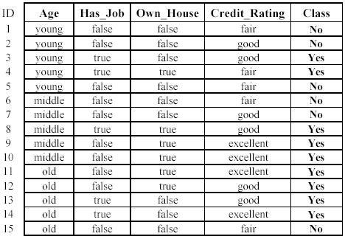
An example: data (loan application)
Approved or not

Slide 7
An example: the learning task
Learn a classification model from the data
Use the model to classify future loan applications into
Yes (approved) and
No (not approved)
What is the class for following case/instance?

Slide 8
Overview …
Supervised vs. Unsupervised Learning
Supervised learning: classification is seen as supervised learning from examples.
Supervision: The data (observations, measurements, etc.) are labeled with pre-defined classes. It is like that a “teacher” gives the classes (supervision).
Test data are classified into these classes too.
Unsupervised learning (clustering)
Class labels of the data are unknown
Given a set of data, the task is to establish the existence of classes or clusters in the data

Slide 9
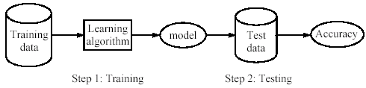
Overview …
Supervised learning process: two steps
Learning (training): Learn a model using the training data
Testing: Test the model using unseen test data to assess the model accuracy

Slide 10
Evaluation Methods
Holdout set: The available data set D is divided into two disjoint subsets,
the training set D_{train} (for learning a model)
the test set D_{test} (for testing the model)
Important: training set should not be used in testing and the test set should not be used in learning.
Unseen test set provides a unbiased estimate of accuracy.
The test set is also called the holdout set.
This method is mainly used when the data set D is large.

Slide 11
Evaluation Methods …
Validation set: the available data is divided into three subsets,
a training set,
a validation set and
a test set.
A validation set is used frequently for estimating parameters in learning algorithms.
In such cases, the values that give the best accuracy on the validation set are used as the final parameter values.
Cross-validation can be used for parameter estimating as well.

Slide 12
Evaluation Methods: Cross Validation
Partition examples into k disjoint sets
Now create k training sets
Each set is union of all equivalent classes except one
So each set has (k-1)/k of the original training data
← Train →
Test
Test
Test

Slide 13
Evaluation Methods: Cross Validation …
k-fold cross-validation: The available data is partitioned into k equal-size disjoint subsets.
Use each subset as the test set and combine the rest k-1 subsets as the training set to learn a classifier.
The procedure is run k times, which give k accuracies.
The final estimated accuracy of learning is the average of the k accuracies.
10-fold and 5-fold cross-validations are commonly used.
This method is used when the available data is not large.

Slide 14
Evaluation Methods: Cross Validation …
cross-validation generates an approximate estimate of how well the learned model will do on “unseen” data
by averaging over different partitions it is more robust than just a single train/validate partition of the data
“k-fold” cross-validation is a generalization
partition data into disjoint validation subsets of size n/k
train, validate, and average over the v partitions
e.g., k=10 is commonly used
k-fold cross-validation is approximately k times computationally more expensive than just fitting a model to all of the data

Slide 15
Classification Measures
Predictive accuracy
Efficiency
time to construct the model
time to use the model
Robustness: handling noise and missing values
Scalability: efficiency in disk-resident databases
Interpretability:
understandable and insight provided by the model
Compactness of the model: size of the tree, or the number of rules.

Slide 16
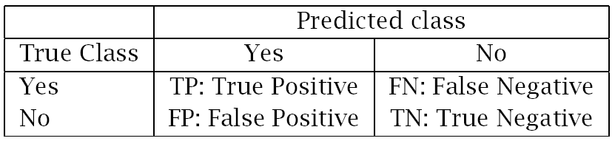
Classification Measures
Confusion Matrix
TP: the number of correct classifications of the positive examples
FN: the number of incorrect classifications of the positive examples
FP: the number of incorrect classifications of the negative examples
TN: the number of correct classifications of the negative examples

Slide 17
Precision and Recall Measures
Confusion Matrix
TP: the number of correct classifications of the positive examples
FN: the number of incorrect classifications of the positive examples
FP: the number of incorrect classifications of the negative examples
TN: the number of correct classifications of the negative examples

Slide 18
Precision and Recall Measures …
Precision p is the number of correctly classified positive examples divided by the total number of examples that are classified as positive.
Recall r is the number of correctly classified positive examples divided by the total number of actual positive examples in the test set.

Slide 19
F1-value (also called F1-score)
It is hard to compare two classifiers using two measures. F₁ score combines precision and recall into one measure
The F score is used to measure a test’s accuracy
The F score reaches the best value, meaning perfect precision and recall, at a value of 1. The worst F score, which means lowest precision and lowest recall, would be a value of 0.

Slide 20


Receive Operating Characteristics (ROC) curve
It is commonly called the ROC curve.
It is a plot of the true positive rate (TPR) against the false positive rate (FPR).
True positive rate:
False positive rate:

Slide 21
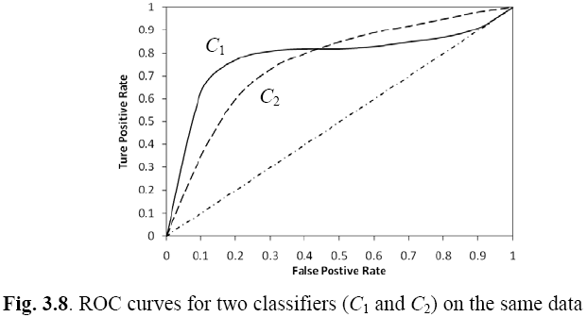
Example ROC curves
ROC cuvers for two classifiers (C1 and C2) on the same data

Slide 22


Area Under the Curve (AUC)
In statistics, there are two other evaluation measures:
Sensitivity: Same as TPR
Specificity: Also called True Negative Rate (TNR)
Then we have

Slide 23
Sensitivity and Specificity
Which classifier is better, C₁ or C₂?
It depends on which region you talk about.
Can we have one measure?
Yes, we compute the area under the curve (AUC)
If AUC for C_{i} is greater than that of C_{j}, it is said that C_{i} is better than C_{j}.
If a classifier is perfect, its AUC value is 1
If a classifier makes all random guesses, its AUC value is 0.5.

Slide 24
Summary

Slide 25

Any Questions ?

